Slide 1
What’s the best fragrance for you?
Pranav Garg
Ronak Goyal
Utkarsh Garg
Alexander Imhoff
John Izzo
Akash Barathan

Slide 2
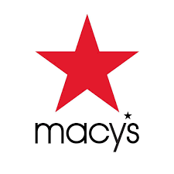
Problem Statement
The Problem: Our client wants to implement an online fragrance recommendation software to boost engagement with their fragrance products.
Can we personalize recommendations of fragrances based off of the desired customer attributes by pulling from past reviews across various brands and fragrance profiles?
Notes:
This problem statement is phrased this way because we want to show business impact in the context of an example. The variety of choice problem is solved here through the recommendation system because it saves consumers’ time by narrowing down the choices based on the fragrance profile they want. It also fits in with the current trend of integrating automation into sectors of the company and help unsure associates who are on the job and may not be the most familiar with fragrances. We framed this problem in the context of Macy’s but this could apply for most retailers that have a fragrance section or sell a large variety of fragrances both online and in-person through kiosk format. Our question provides a solution that is missing from the current market as well; for example, if we look at amazon’s perfume/cologne/fragrance page it has some options to select such as what chemicals does the user want/not want in their perfume as well as generally popular brands. However, there isn’t really a way for the consumer to specify a profile and get the top brands specifically for that profile. This is where our recommender system comes in and fills in that gap by prompting the user for the profile that they want to see which should be used alongside pre existing filter options in companies like Amazon in their online/in-person systems.

Slide 3

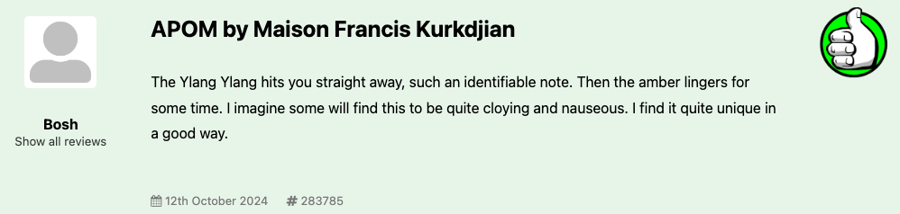
Our Data Source
Scraped from Base Notes fragrance discussion forum
Each review scraped includes sentiment rating (positive, negative, or neutral)
Around 44k total reviews scraped up until December 2019
Notes:
Base Notes is a perfume/cologne discussion and review forum. Users write out reviews for the specific products they’ve tried, and each review contains a sentiment left by the user (positive, negative, or neutral). During the scraping process, we extracted a total of 44,000 reviews that were written no later than December 2019. Also, in these reviews, the title was usually in a specific format which was product name + brand name, meaning we would need to separate this in processing.

Slide 4
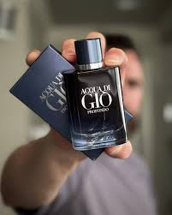
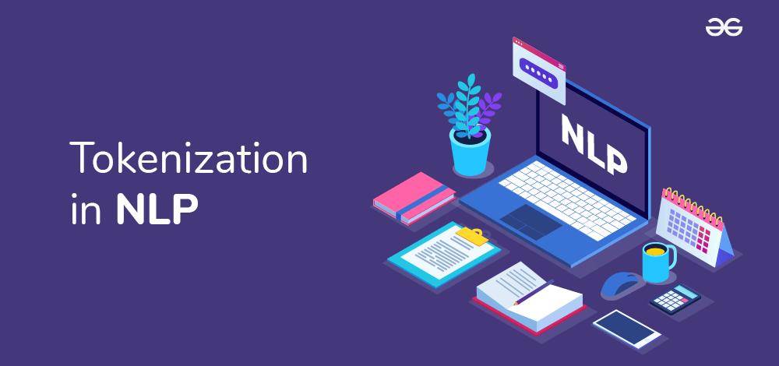
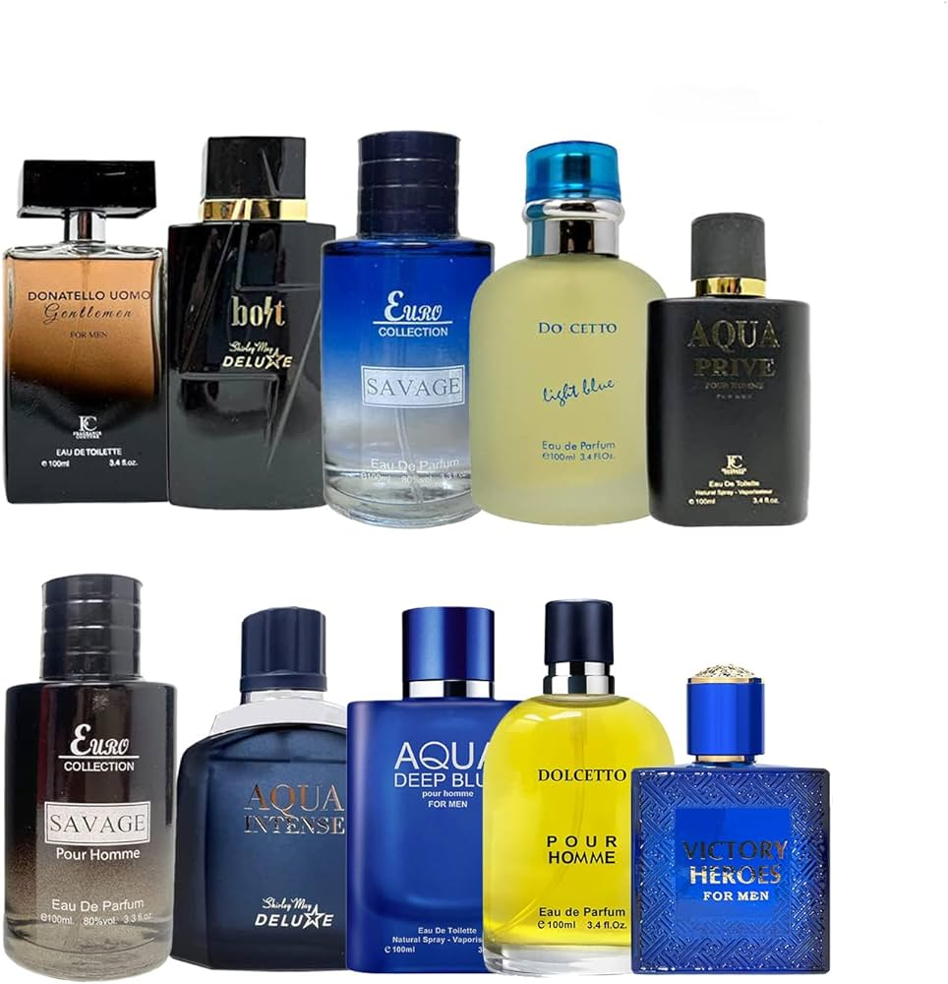
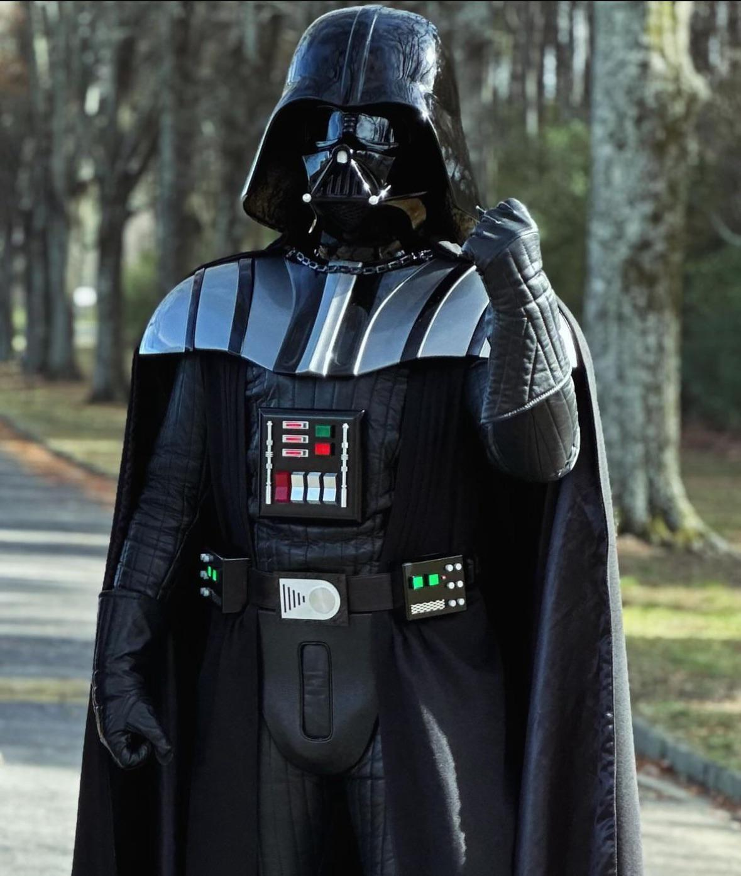
Process
Scraping
Pre-Process
Topic Modeling/BERT
Calculate Similarities
Output Recommendations
Extracted fragrance reviews
Text cleaning
Tokenization
Found common scent profiles
SpaCy Similarity scores
Vader Sentiment
User Input
Query Website API
Notes:
The scraper used selenium to extract various features of the review, including the title of the review, which had brand name and product name
the ‘sentiment’ there which was displayed as a thumbs up/down/neutral and assigned a number in our code, and lastly, the review itself,
. [In order to ensure that the text reviews were ready for analysis, several preprocessing tasks were executed on the scraped data. First, unicode characters were normalized and any non-ASCII characters were ignored. Afterwards, we removed all punctuation and formatted each review into all lowercase letters. Finally, the text was tokenized and all stop words were removed from the tokens. [
Topic modeling using BERT to understand our data, and attempt to find common scent profiles - we imagined that groups of similar adjectives would be put together, and the perfumes that had these adjectives would also be there
Used spacy similarity scores and vader sentiment analysis to relate each perfume’s reviews to a user-input query, and get positive ratings of similar perfumes (sentiment and similarity) to…
Output a recommendation of perfumes based on the query.

Slide 5
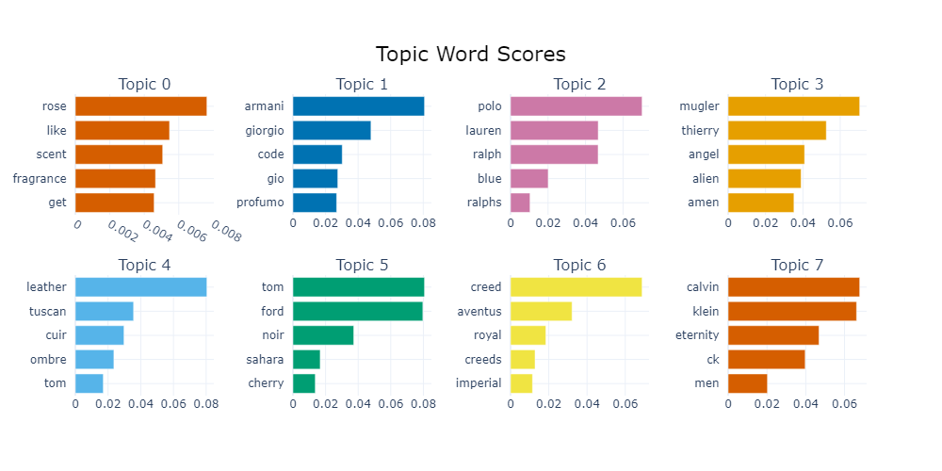
Each chart represents top words for a topic ranked by importance and frequency
Perfumes related to such topics will contain the ranked words shown in their reviews
88 total topics
Notes:
Alex
About 99 topics in total, with the first 2 accounting for over half of the 13000 reviews
Many brands are lumped into topics together, or with attributes, these most common topics have brands and perfumes at the top - very popular?
Describe topic 5 - tom ford noir is a perfume, and attributes (descriptors) sahara and cherry with it
Topic 6 - Creed had perfumes aventus, royal, and imperial

Slide 6
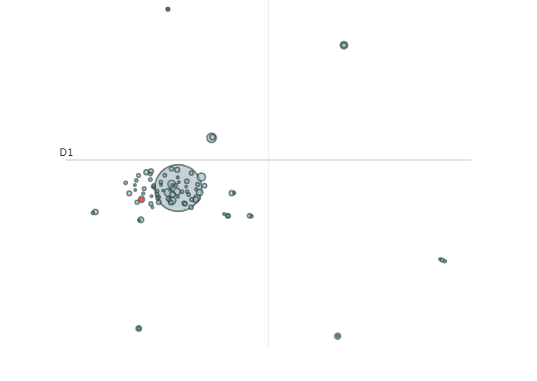
Notes:
Alex
More detailed look at topics
Topic 0: most common words throughout corpus - like, fragrance, scent, rose
Top right: alchemy, lab, phoenix, black, halloween
Bottom right paco rabanne million xs phantom
Bottom left azzaro pour homme chrome fever
Both brands and perfumes
Center cluster - topic 50: floris santal majuscule (perfume) sandalwood oriental (attributes)
10 - gabbana dolce blue light pour
Topics often represent perfumes, as the perfumes are the most ‘semantically divisible’ part of the reviews

Slide 7
Case Study: Consumer X
Customer X visits a Macy’s store and wants a fragrance that is exotic. They enter these attributes into the kiosk system:
Title | Spacy
Allure Parfum | 0.530252
Love | 0.528271
Aoud Amber Rose | 0.524715
Coastal Salty Forest | 0.520848
Burberry Brit Sheer | 0.518956
Notes:
This case study demonstrates an example of our recommendation system’s functionality to a customer that is unfamiliar with what fragrance they want. In this case, consumer x inputs some desired attributes into the kiosk. Behind the scenes, our software will determine which fragrances have the highest spacy similarity scores based off of the reviews. These fragrances will then be outputted back to the user along with their prices to give the user an idea of what to buy.

Slide 8
Final Takeaways
Utilize wisdom of crowds to turn a user’s desired attributes into a reliable perfume recommendation
The recommendation system benefits the user by outputting both a recommended brand and product to buy
Topic modeling can help from a business point of view to identify the attributes that the customers desire the most
The software can increase customer satisfaction by combatting decision fatigue
Helps Macy’s determine new brands they should acquire based off the inputted customer attributes
Notes:
Marketing
Opening up the stores based on the demographics of that location

Slide 9
Future Work
Implementing sentence transformers (topic modeling)
In this run it took too much time to run and was difficult to run on a large volume of reviews
Gathering more metadata on consumer behavior and using that alongside to enhance recommender
Clickstream, Personalization, Demographics
Enhancing price pull API, for any client using recommender including Macy’s
Can display prices alongside brand, accounting for consumer budget
Outputting the location (aisle number) of the customer’s desired fragrance
Notes:
{draft}
Tried sentence transformers for topic modeling - this would capture more relationships of words and meaning in the text, likely reducing many (5k) documents with -1 as the dominant topic, which means that review has no specific topic
Running this takes several hours and is not well suited for a collab notebook and 13k reviews
More often then not, customers may not have a clear idea of the fragrance product they're looking for. By leveraging clickstream data, personalization insights, and demographic information, Macy’s can enhance its recommendation system. These data points can help create tailored, out-of-the-box suggestions, enriching the customer experience, especially when they are searching for something specific. This refined recommendation system can also help Macy’s segment its fragrance offerings more effectively, optimize pricing strategies, and allocate ad budgets more efficiently for maximum conversions and customer satisfaction.
Additionally, google search API has not been the best at pinpointing the perfumes, can use a better API or enhance search capabilities.
Additionally, system can show aisle and shelf of the products recommended for the in-person kiosks that use the system and for online users store location.

